Slide 1


Empower Your Security: A Beginners Guide to Threat Modeling

Slide 2


Bio
Threat Modeling - 10 years
TMC - Founding Member
James Rabe
linkedin/in/jrabe3

Slide 3

Discussion Topics
What is Threat Modeling?
What are the benefits of Threat Modeling?
Threat Modeling Key Concepts
Threat Modeling Applications

Slide 4

What is Threat Modeling?
Threat Modeling is a proactive assessment of risk which starts with a well scoped description of change and results in a prioritized list of realistic threats and prioritized set of cost-effective mitigations with a timeline and plan for risk reduction.

Slide 5

Breaking Down Threat Modeling
Proactive Assessment of Risk
Pre-Change Focused - Finding the problems as early as possible (design) vs finding them post implementation (production)
Problem Seeking - anticipating problems
Risk-Focused - organizational risk appetite

Slide 6
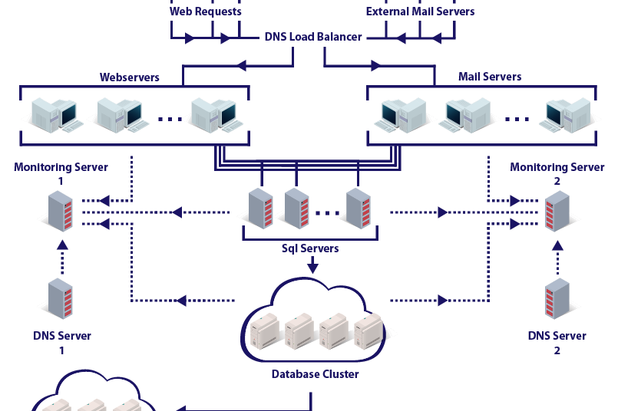
Breaking Down Threat Modeling
Well Scoped Definition of Change
Accurate Enough Description of the Change
Limited Scope to Prevent Over-Analysis
Diagram Based
Story Based
Should include what is not in scope

Slide 7

Breaking Down Threat Modeling
Prioritized List of Realistic Threats
Realistic Threat - Exploit likely threats
Prioritized
Enumerated and Cataloged
Tracked

Slide 8
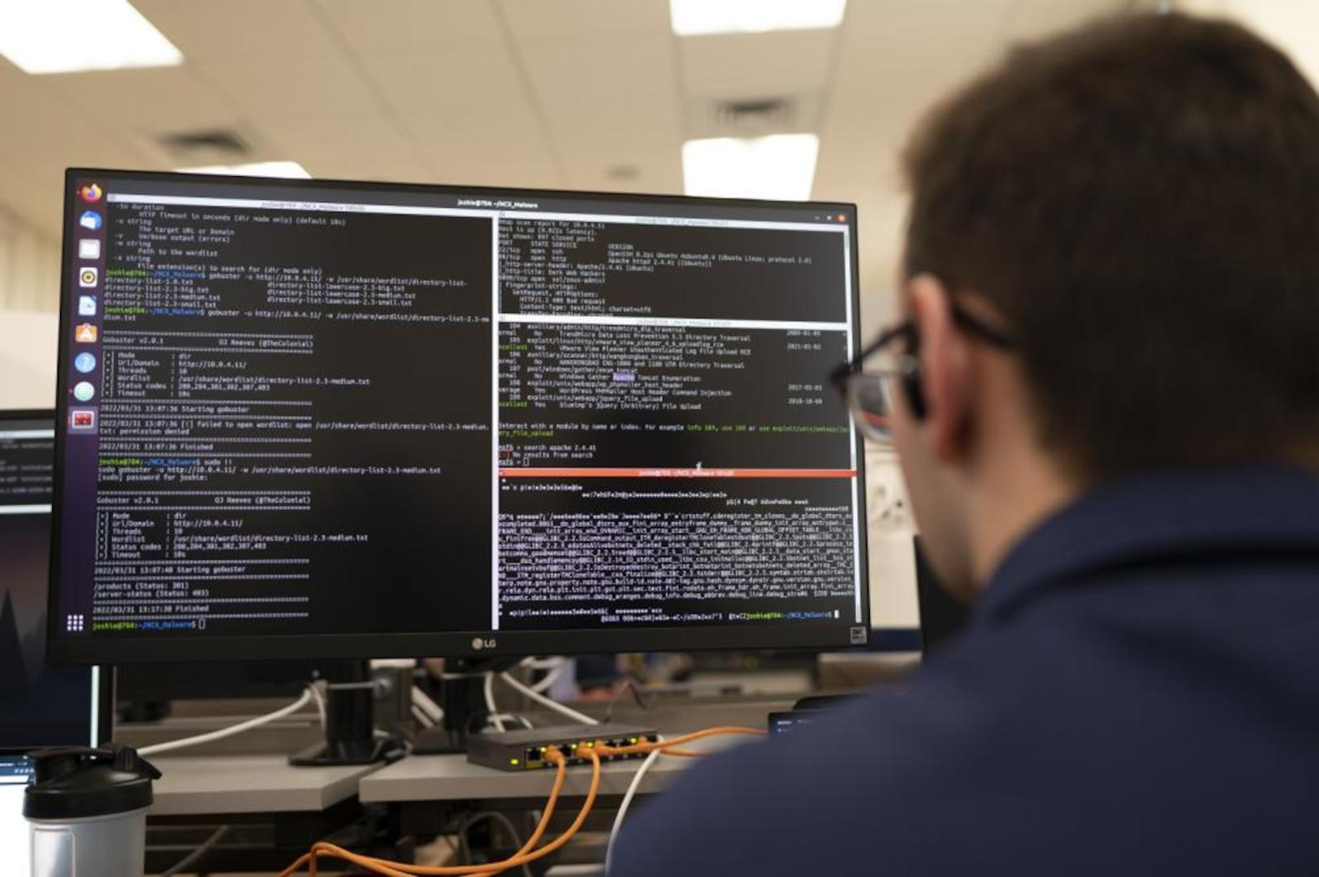
Breaking Down Threat Modeling
Prioritized List of Cost-Effective Mitigations
Mitigating Factors - Design Based or Corrective Based
Cost-Effective
Prioritized (not everything is urgent)

Slide 9

Breaking Down Threat Modeling
Timeline and Plan
Realistic & Flexible Timelines
Document dependencies
Barriers to success
Agile Milestones
Stakeholder Buy-in
Assigned and Responsible Personnel

Slide 10


Slide 11

Breaking Down Threat Modeling
Risk Reduction
Threat Modeling should always result in a better risk position
Security (Aka Risk Management) is everyone’s job
Is the ball closer to the hole?

Slide 12
Threat Modeling Process
What are we working on?
What can go wrong?
What are we going to do about it?
Did we do a good job?
Scoping
Business Alignment
Threats
Mitigations

Slide 13
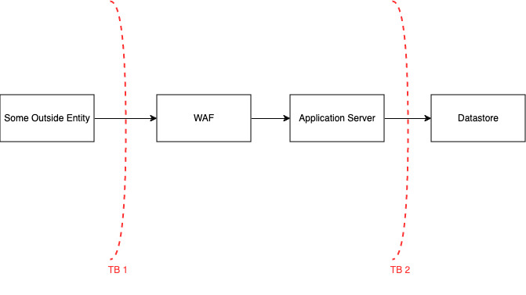
Notes:
Completed in draw.io but you could have also done this on a whiteboard, with a deck of cards or using an application that focuses on Threat Modeling. There are several community free products available to provide an interface with Threat Modeling.
Depending on what I am building I can structure my threat model into different layers

Slide 14
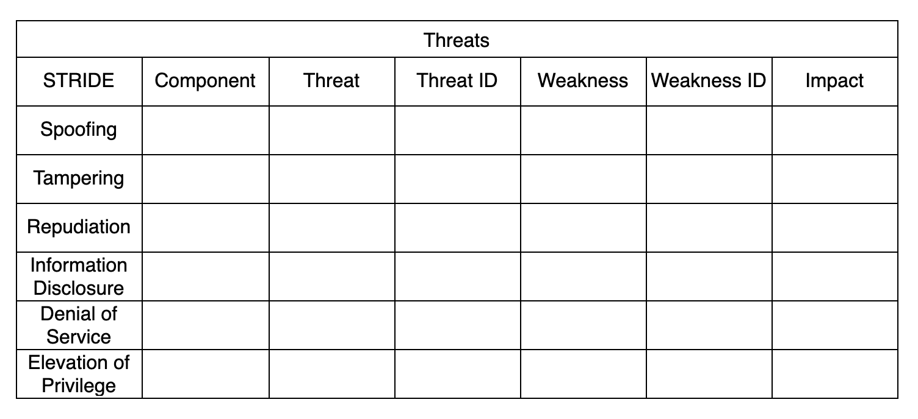
Notes:
We could have also added Threat Actor, likelihood, ease of exploit

Slide 15
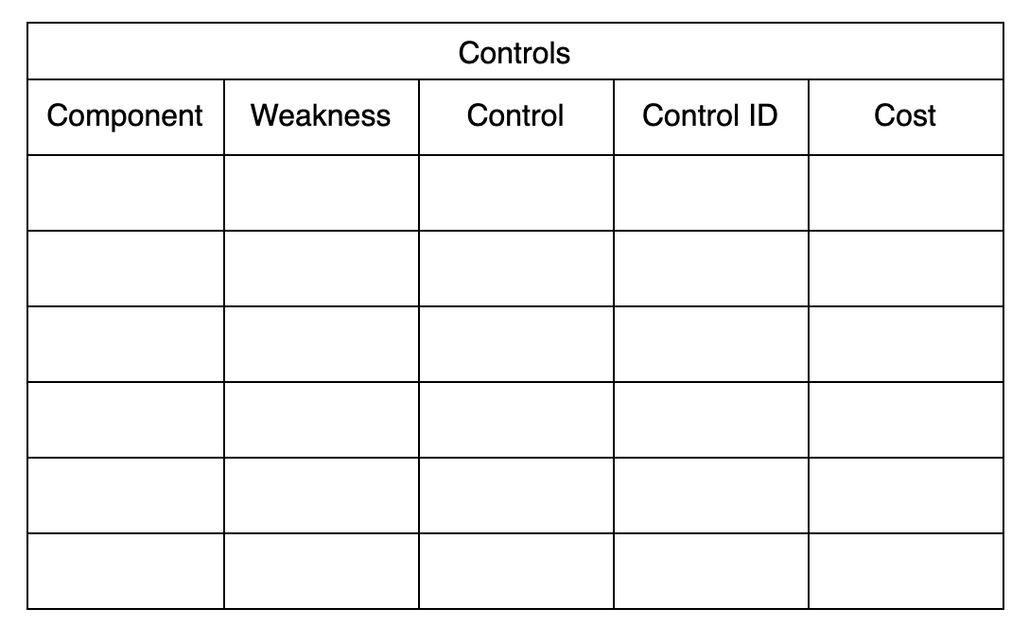
Notes:
We could have also added something like resource, timeline,

Slide 16
Freesources (Free + Resources)
Free Platform for Threat Modeling - https://community.iriusrisk.com
OWASP Threat Modeling Cheat Sheet - https://cheatsheetseries.owasp.org/cheatsheets/Threat_Modeling_Cheat_Sheet.html
World’s Shortest Threat Modeling Course - https://www.youtube.com/watch?v=2pvprvsr1lo
Threat Modeling Connect - https://threatmodelingconnect.com

Slide 17
Connect with me
James Rabe
linkedin/in/jrabe3

